Slide 1

Designing APIs with OpenAPI
Mike Amundsen @mamund

Slide 2


Slide 3
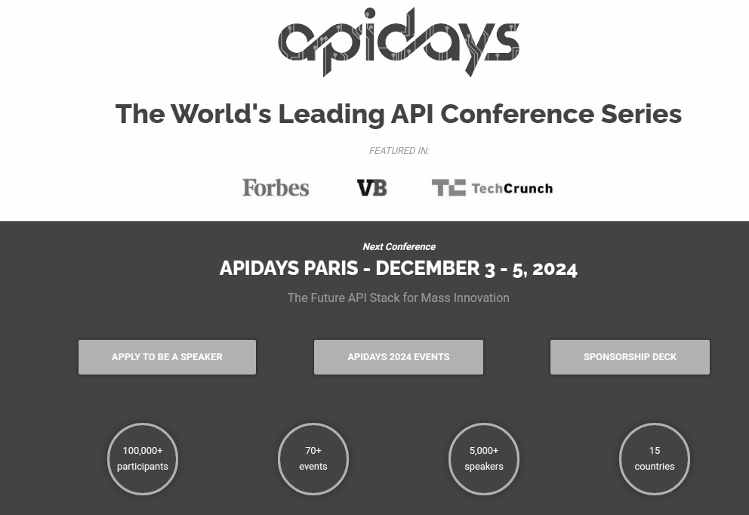
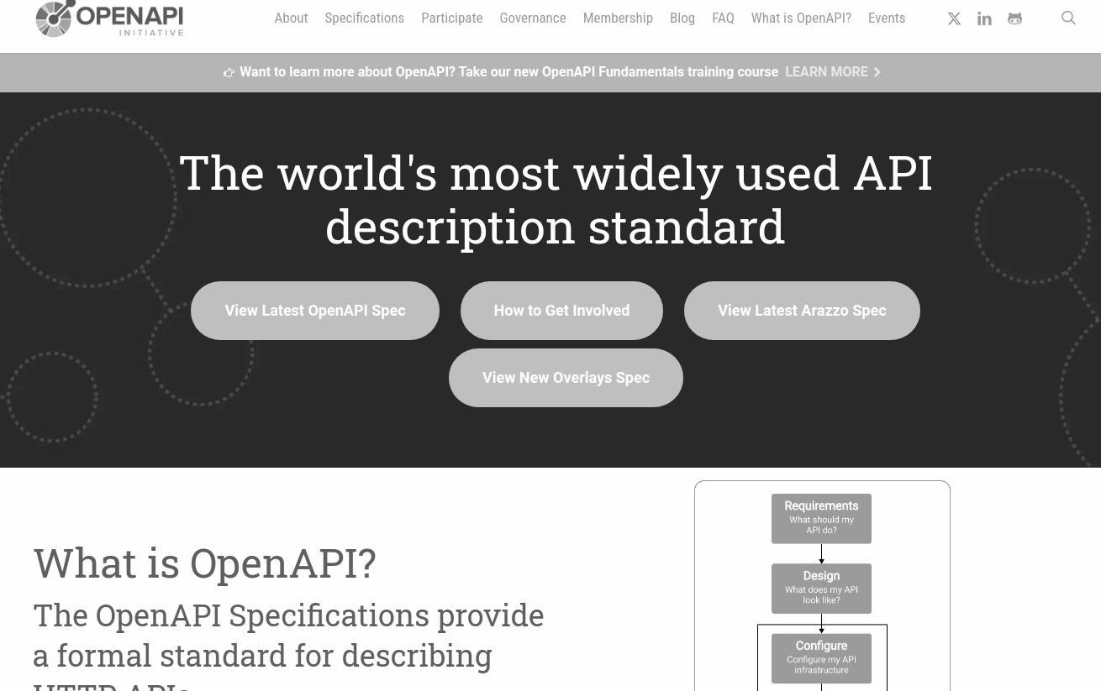
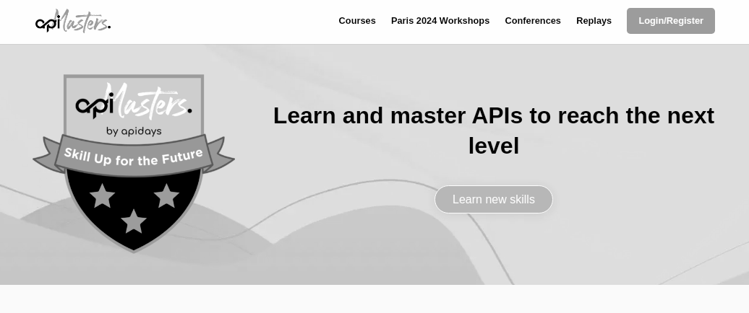

Slide 4

Designing APIs with OpenAPI
The Power of API Design
API Design Assets
Prototyping Your API Design with OpenAPI
Leveraging OpenAPI Components
Defining OpenAPI Paths
Mocking and Testing Your API Design
Modifying Your API in Production
Review

Slide 5

The Power of API Design

Slide 6
The Power of API Design
API-First
Norman's Lifecycle
Three Pillars of API Design
Exercise: Identify Your Three Pillars

Slide 7
API First
Identify key actors
Before you build …
First class citizens

Slide 8
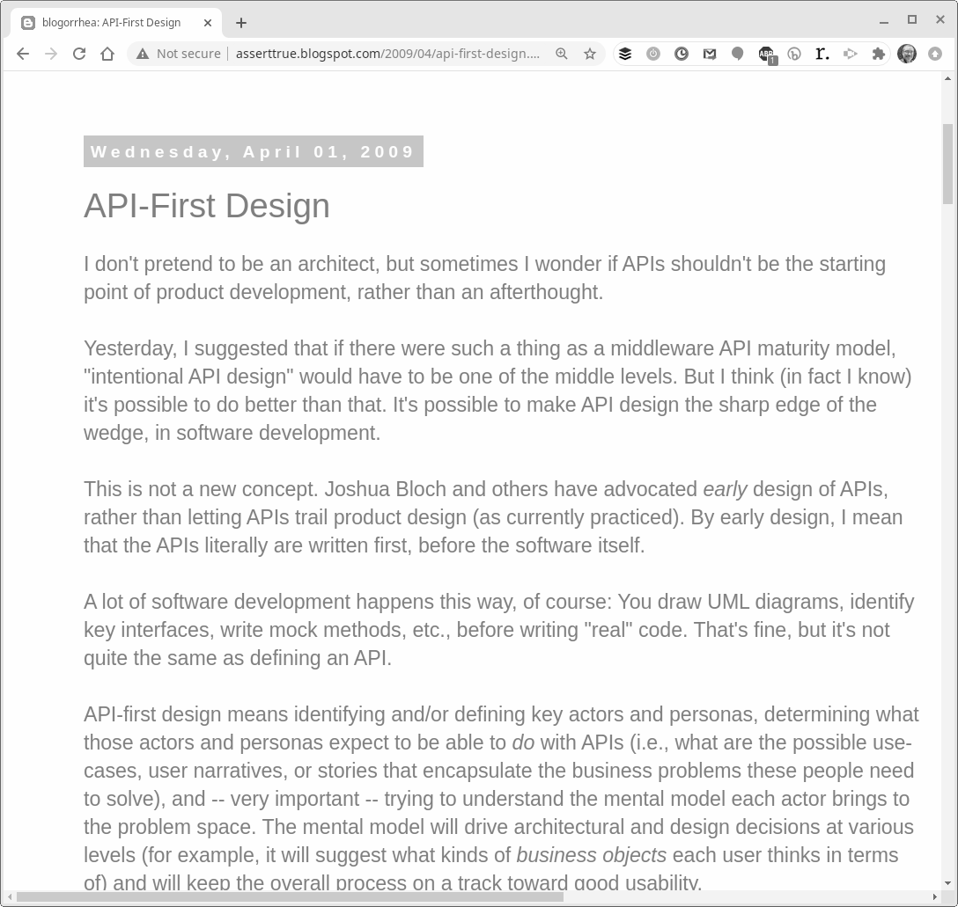

http://asserttrue.blogspot.com/2009/04/api-first-design.html

Slide 9
"API-first design means identifying and/or defining key actors and personas, determining what those actors and personas expect to be able to do with APIs" -- Kas Thomas, 2009
http://asserttrue.blogspot.com/2009/04/api-first-design.html

Slide 10
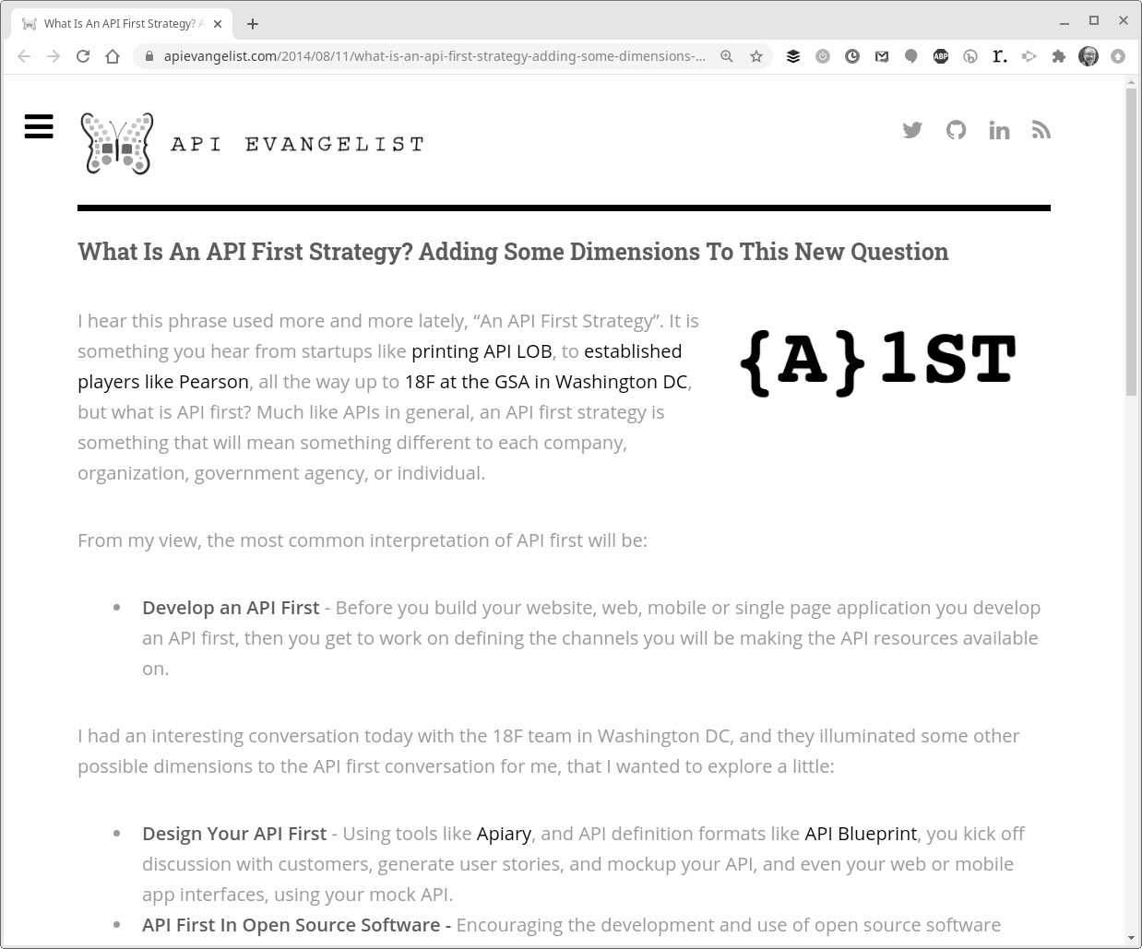

https://apievangelist.com/2014/08/11/what-is-an-api-first-strategy-adding-some-dimensions-to-this-new-question/

Slide 11
"Before you build your website, web, mobile or single page application you develop an API first." -- Kin Lane, 2014
https://apievangelist.com/2014/08/11/what-is-an-api-first-strategy-adding-some-dimensions-to-this-new-question/

Slide 12
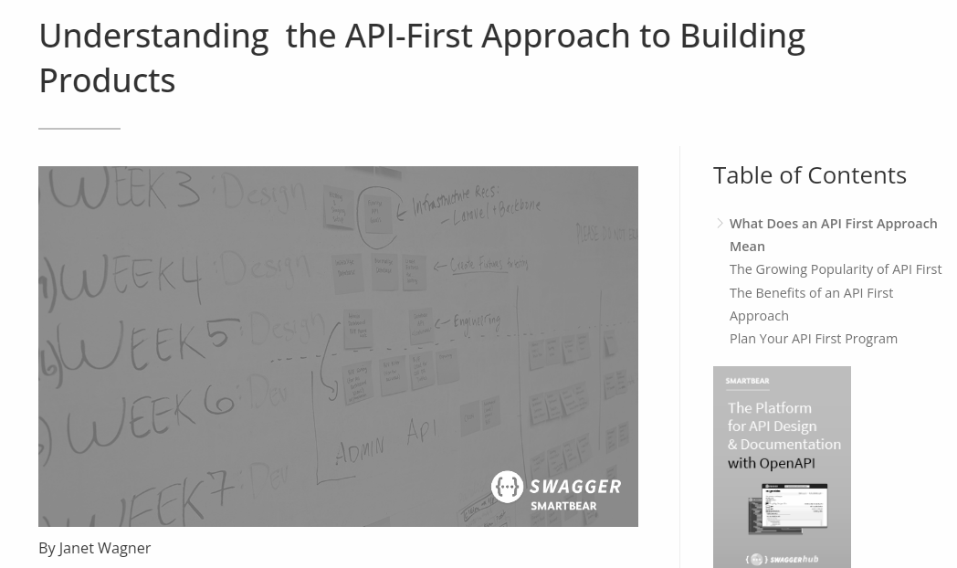

https://swagger.io/resources/articles/adopting-an-api-first-approach/

Slide 13
"An API-first approach means that for any given development project, your APIs are treated as 'first-class citizens.'"
-- Janet Wagner
https://swagger.io/resources/articles/adopting-an-api-first-approach/

Slide 14
Norman's Lifecycle
Donald Norman's Action Lifecycle
Three stages
Goal formation
Execution
Evaluation

Slide 15
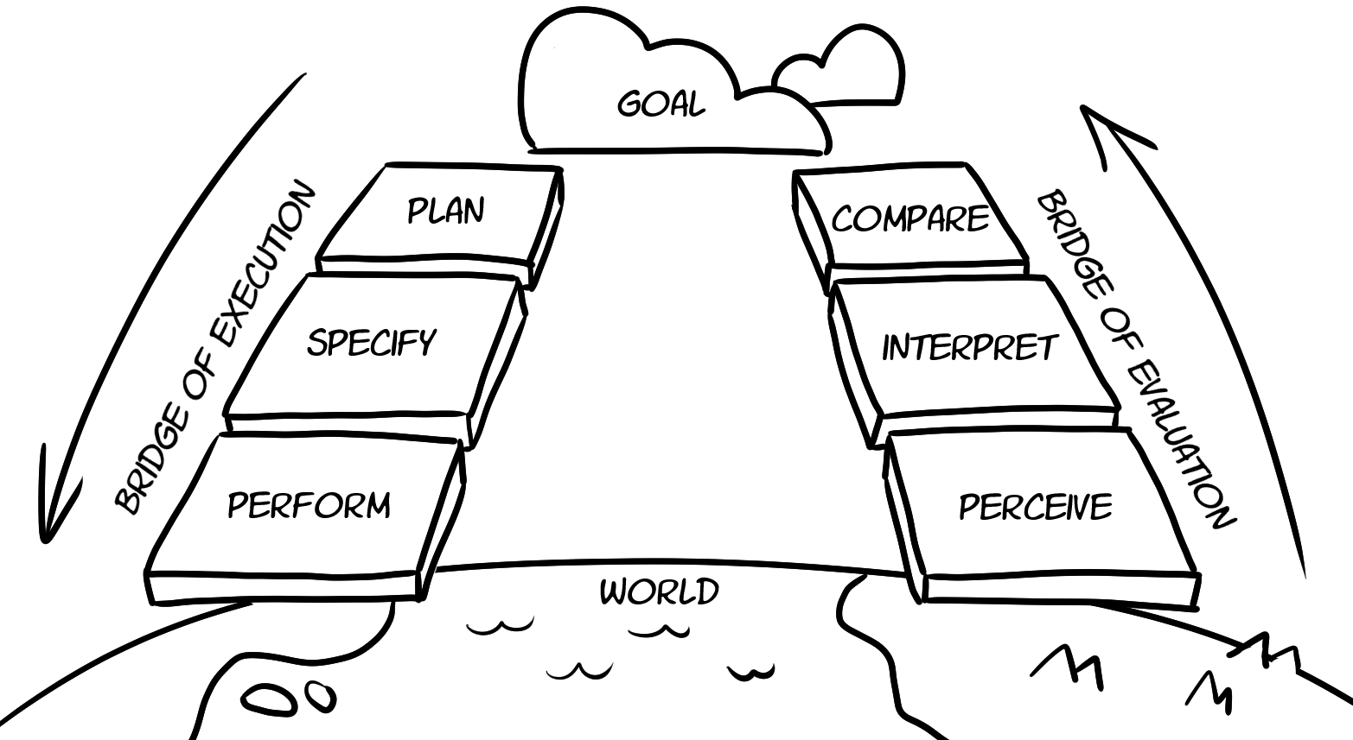
Norman's Lifecycle

Slide 16
Norman's Lifecycle
Donald Norman's Action Lifecycle
Three stages
Goal formation
Execution
Evaluation
Identify action lifecycles

Slide 17
Three Pillars of API First
Business Problem
What business problem does this API solve?
Target Audience
Who will use this API? And why?
Actual Design
What designs solve this problem for this audience?

Slide 18
Exercise: Identify Your Three Pillars
Create a short document that :
Identifies a business problem to solve w/ your API
Defines a target audience for your API
Describes some key features of your API solution
No more than ~150 words

Slide 19
The Power of API Design : Review
API-First
First class citizen
Norman's Lifecycle
Everything is a loop
Three Pillars of API Design
Business, audience, design features

Slide 20

API Design Assets

Slide 21
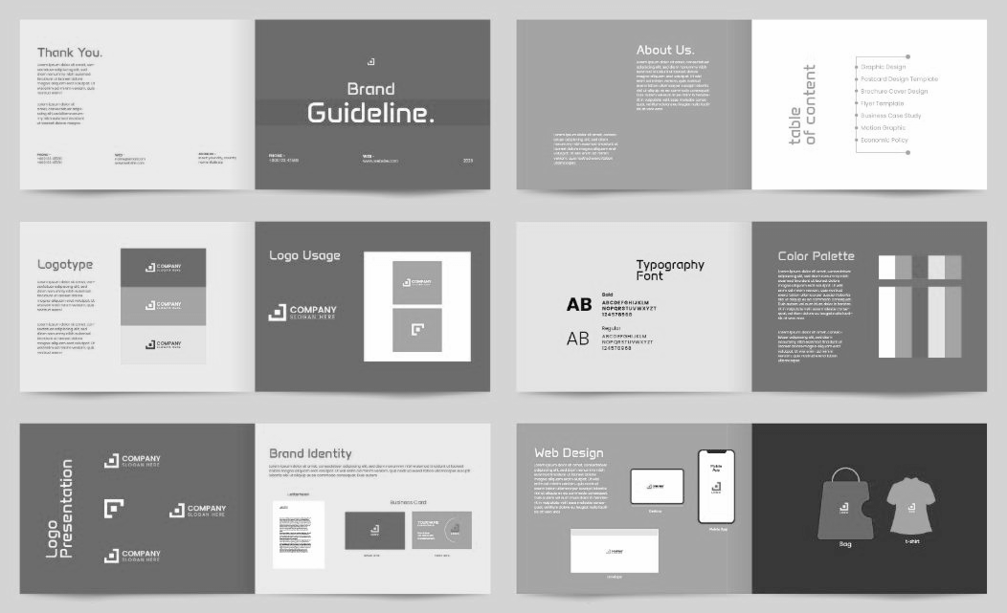
Design Assets
Design assets are any digital resources that are created or used in the design process.
-- Uxcel
https://app.uxcel.com/glossary/assets

Slide 22
API Design Assets
API Story
API Diagram
API Vocabulary
Exercise: Assemble Your Design Assets

Slide 23
API Story
APIs start with a story
"We need…"
"Our customers requested…"
"I have an idea…"
Stories are shared understanding
Our brains are wired for stories, not data
Stories are accessible
Stories are repeatable

Slide 24
API Story
Purpose
Short description of the purpose/goal
Actions
A list of all the supported actions
Data
A list of all the data elements
Rules
A list of rules that govern the data mgmt
Processing
Any additional processing handled by the API

Slide 25
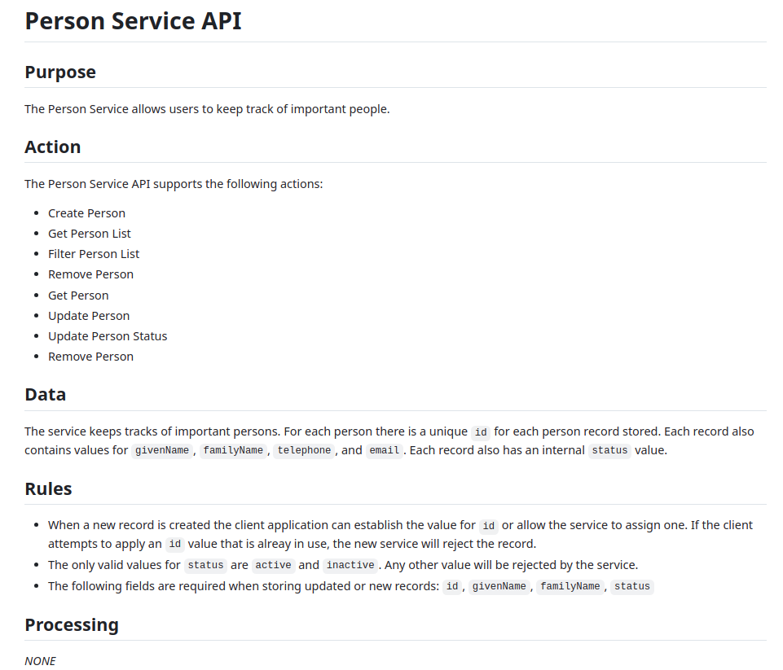

Slide 26
API Diagram
Visual representation of the API
Not a state diagram
Not a flow diagram
An interaction diagram

Slide 27
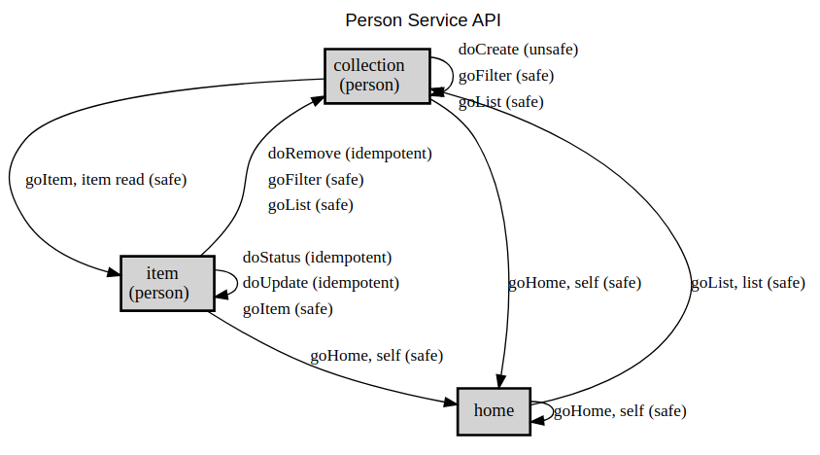

Slide 28
API Vocabulary
All the "magical words" related to API domain
Not just the properties:
id, givenName, etc.
Also :
Actions (create, approve, save, etc.)
Enumerators (status.active, status.inactive)
Containers (item.id, item.givenName, etc.)
Resources/Topics (home, collection. item)

Slide 29
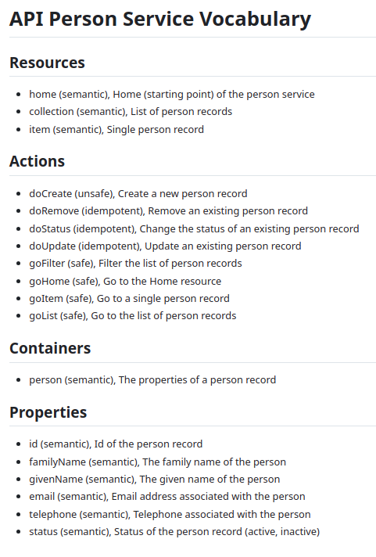

Slide 30
Exercise: Assemble Your API Design Assets
Create an API Story for your API
Purpose
Actions
Properties (Data)
Rules
Processing
1-3 are required, 4 & 5 are optional

Slide 31
API Design Assets : Review
API Story
Shared, accessible, repeatable
API Diagram
Display the interactions
API Vocabulary
The "magical words" of the API

Slide 32

Prototyping Your API Design

Slide 33
Prototyping Your API Design
What is an API Prototype?
Why Use Prototypes?
OpenAPI Info Section
Exercise : Create Your OpenAPI Document

Slide 34
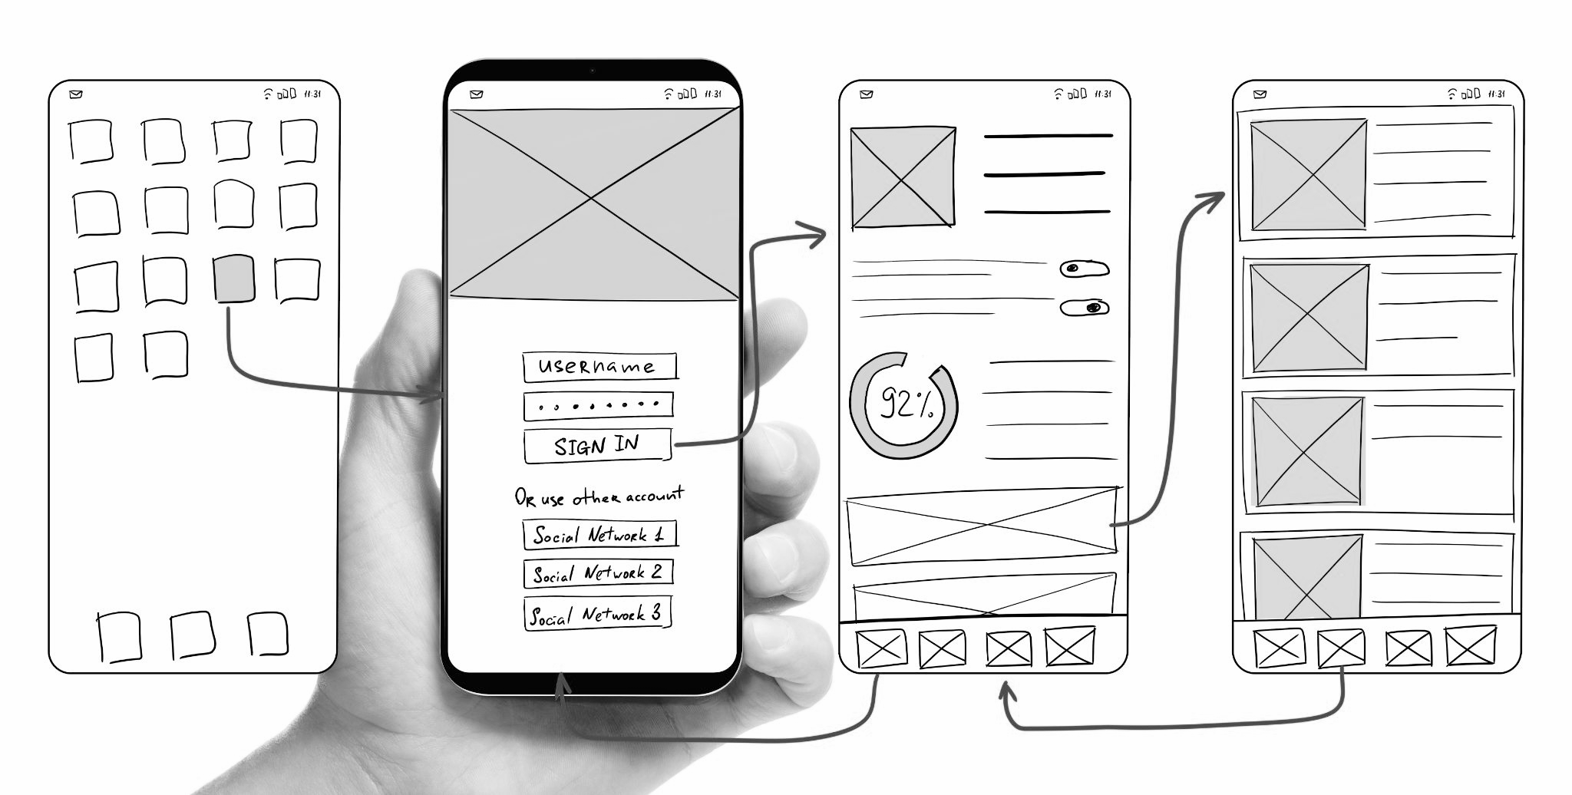
What is an API Prototype?
A first, typical or preliminary model of something, especially a machine, from which other forms are developed or copied.
-- Oxford Dictionary

Slide 35
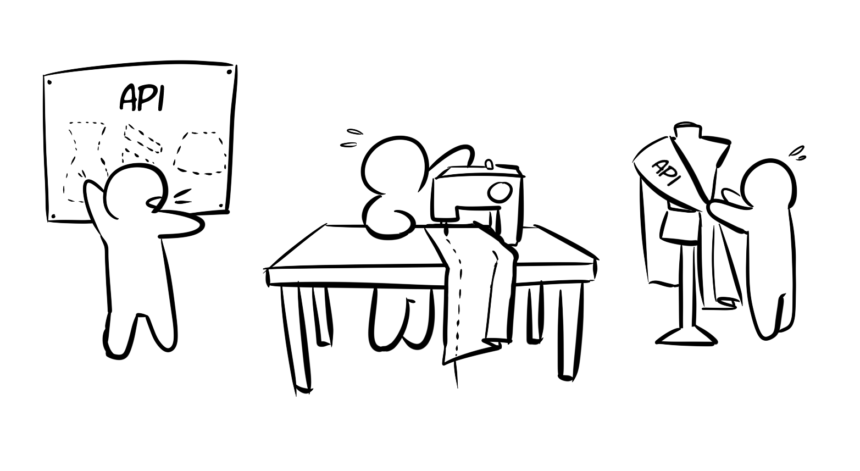
Why use prototypes?
Inexpensive experiments
Explore the details
Prototypes are made to be tested

Slide 36
Why use prototypes?
Inexpensive experiments
Explore the details
Prototypes are made to be tested

Slide 37
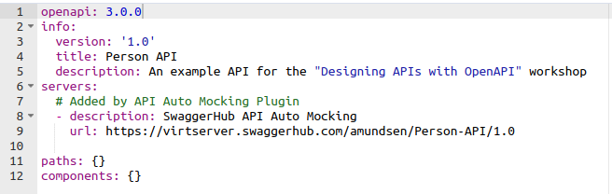
OpenAPI Basic Info
Contains the basic shared information about your API
Key elements to include are:
version
title
description
Other elements:
servers
paths
components

Slide 38
Exercise: Create Your OpenAPI Document
Create the initial OpenAPI document for your API
Open the SwaggerHub editor
Log in
Select "Create New -> Create New API"
Fill in the dialog
See exercise document for details

Slide 39
Prototyping Your API Design : Review
What is an API Prototype?
A preliminary model
Why Use Prototypes?
Prototypes are made to be tested
OpenAPI Info Section
Version, title, description

Slide 40

Leveraging OpenAPI Components

Slide 41
Leveraging OpenAPI Components
The OpenAPI Components Section
Parameters, Schemas, Responses, & RequestBodies
Exercise: Populate your OpenAPI Component Section

Slide 42
The OpenAPI Component Section
The components section helps organize your API definition
Establish consistency in your API design
parameters : typically for query strings (?id=123)
schemas : typically for response objects (person, job, etc.)
responses : for other replies (e.g. error messages)
requestBodies : for sending data in POST

Slide 43
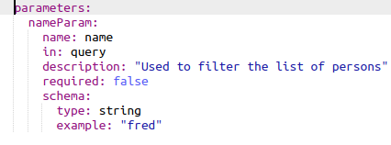
The OpenAPI Component Parameters
Important properties:
name, in, required, schema/type
Recommend properties:
Description
example

Slide 44
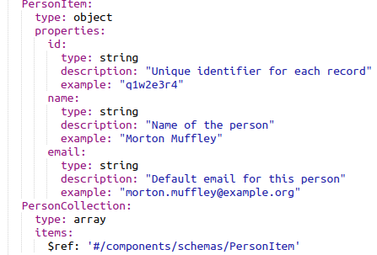
The OpenAPI Component Schemas
Important properties:
Type (object/array)
Properties (type, description, example)

Slide 45
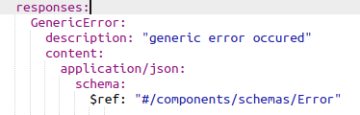
The OpenAPI Component Responses
Important properties:
Content (media type)
Schema (use $ref)
Also:
Include description

Slide 46
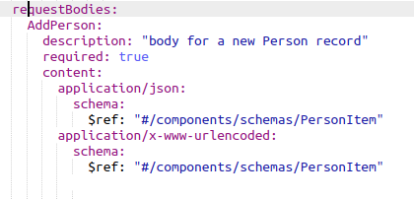
The OpenAPI Component RequestBodies
Use to support arguments in POST/PUT requests
Important properties:
Description, required, content, schema
Note: you can support more than one content element

Slide 47
Exercise: Populate OpenAPI Components
Update your OpenAPI document component section with:
At least one query parameter (e.g. ?id=)
At least one schema item/collection pair of objects
At least one response item (e.g. HomeResponse)
At least one requestBodies item (e.g. addItem)
See exercise document for examples

Slide 48
Leveraging OpenAPI Components
The OpenAPI Components Section
Organize your OpenAPI definition
Improve the consistency of your API design
Parameters, Schemas, Responses, & RequestBodies
Parameters for inline queries
Schemas for shared objects (item/collection)
Responses for general use responses (e.g. errors)
requestBodies for POST/PUT requests (e.g. addItem)

Slide 49

Defining OpenAPI Paths

Slide 50
Defining OpenAPI Paths
The OpenAPI Paths Section
Elements of a Path Definition
Exercise: Document Your OpenAPI Paths

Slide 51
The OpenAPI Paths Section
Paths are the 'heart' of OpenAPI documents
One top-level entry for each resource/URL
One or more HTTP methods for each resource
One or more parameters, requestBodies, responses

Slide 52
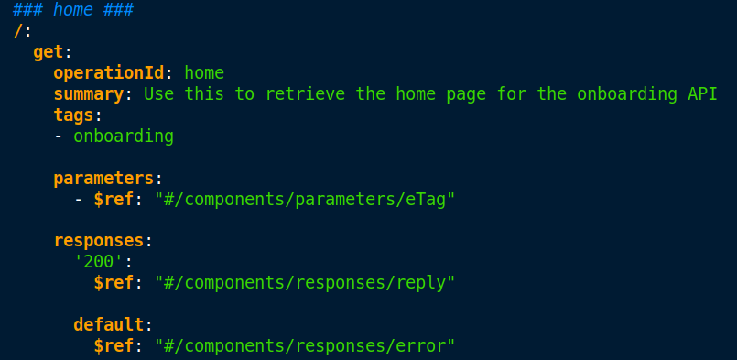
Elements of a Path Definition

Slide 53
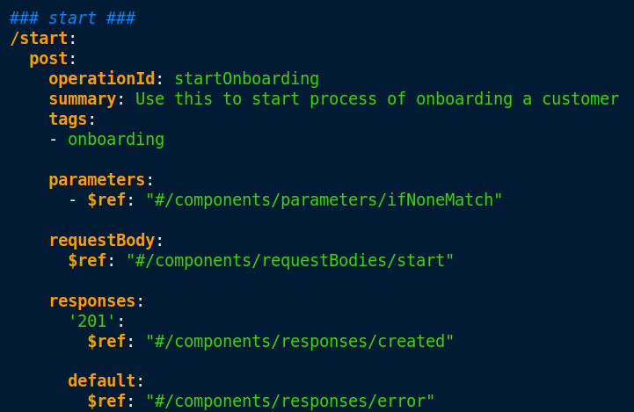
Elements of a Path Definition

Slide 54
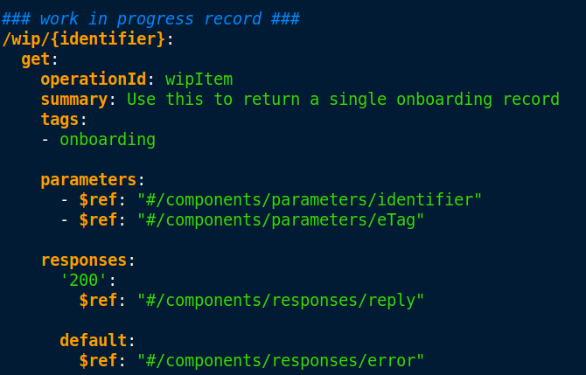
Elements of a Path Definition

Slide 55
Exercise: Document your OpenAPI Paths
Add path elements to your OpenAPI document
One or more URLs (/, /collection, /collection/{identifier}, etc.)
One or more methods per URL (GET, PUT, DELETE, etc.)
Add parameters, requestBody, and response as needed
Update your components section when appropriate

Slide 56
Defining OpenAPI Paths : Review
The OpenAPI Paths Section
paths are the 'heart' of OpenAPI documents
Elements of a Path Definition
Top-level resource url
One or more HTTP methods
parameters, requestBody, and response

Slide 57

Mocking and Testing Your API Design

Slide 58
Mocking and Testing Your API Design
What is a Mock?
Generating API Mocks with OpenAPI
Writing Simple Request Tests (SRTs) for OpenAPI
Exercise: Test your Mock API

Slide 59

Mocking and Testing Your API Design
"I unwittingly discovered the concept of a Mock out of necessity!"
-- Gerard Meszaros

Slide 60
Generating API Mocks with OpenAPI
Mock testing is a software testing technique that involves creating simulated or artificial components, known as mocks, to mimic the behavior of real components in a system.

Slide 61
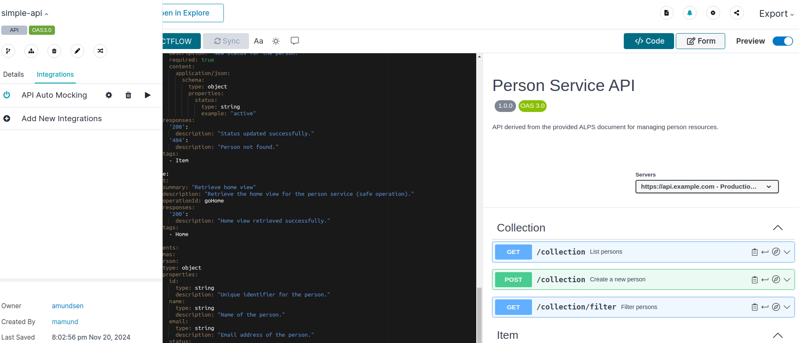
Generating API Mocks with OpenAPI

Slide 62
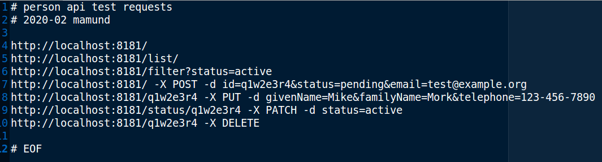
Writing Simple Request Tests for OpenAPI
SRTs are a great way to validate endpoints
Use curl to execute simple requests against your API
"Eyeball" the results to make sure it works as expected
Does the request fail?
Does the body "look ok?"

Slide 63
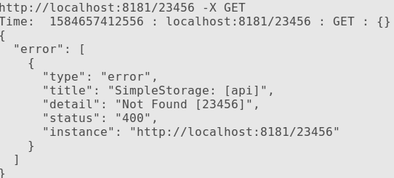
Writing Simple Request Tests for OpenAPI
SRTs are a great way to validate endpoints
Use curl to execute simple requests against your API
"Eyeball" the results to make sure it works as expected
Does the request fail?
Does the body "look ok?"

Slide 64
Exercise: Test Your Mock API
Turn on mocking for your OpenAPI in Swagger Editor
Edit your copy of the SRT list to include your mock URL
Run the SRT script to confirm your mosk is up and running
Optionally, add more URLs to your SRT script to create additional tests for your API mock.

Slide 65
Mocking & Testing Your API Design : Review
What is a Mock?
Simulated test object/target
Generating API Mocks with OpenAPI
Mocks make it easy to test
Writing Simple Request Tests (SRTs) for OpenAPI
SRTs make testing easy

Slide 66

Modifying Your API in Production

Slide 67
Modifying Your API in Production
Beyond Versioning
Three Rules for Modifying Production APIs
Testing and Deploying Modified APIs
Exercise: Verify the Safety of your API Modifications

Slide 68
Beyond Versioning
Dealing with Change
Change is a feature, not a bug
First, Do No Harm
You may not know who your consumers are
Forking Your API
Multiple forks mean multiple versions in production
"First, do no harm" is the Hippocratic Oath of APIs

Slide 69
Three Rules for Modifying Production APIs
Take Nothing Away
Features are frozen
Don't Redefine Anything
Meaning is frozen
Make All Additions Optional
No new REQUIRED inputs

Slide 70
Testing and Deploying Modified APIs
Use all existing tests
Do not replace/rewrite them
Add new tests for the modifications
Be sure to test all the new features
Run all tests (existing & new) everytime

Slide 71
Testing and Deploying Modified APIs
Support Reversible deployments
You MUST be able to "undo" a production update
Use the Salesforce approach (forking)
Support side-by-side releases
Use the AWS approach (overwriting)
Only release in-place compatible updates

Slide 72
Verify the Safety of Your API Modifications
Modify your existing OpenAPI design and re-run your tests
Start with your existing OpenAPI document
Make sure your SRT script passes all tests
Add a new URL resource, method, or parameter to your API
Update your SRT script to test the new design element
Re-run the tests (both existing and new) to confirm safe modifications
See exercise for additional details

Slide 73
Modifying Your API in Production : Review
Beyond Versioning
First, do no harm
Three Rules for Modifying Production APIs
Take nothing away, don't redefine, additions are optional
Testing and Deploying Modified APIs
Don't replace tests, support reversible releases, salesforce vs AWS

Slide 74
Review

Slide 75
Designing APIs with OpenAPI : Review
The Power of API Design
API Design Assets
Prototyping Your API Design with OpenAPI
Leveraging OpenAPI Components
Defining OpenAPI Paths
Mocking and Testing Your API Design
Modifying Your API in Production

Slide 76
The Power of API Design : Review
API-First
First class citizen
Norman's Lifecycle
Everything is a loop
Three Pillars of API Design
Business, audience, design features

Slide 77
API Design Assets : Review
API Story
Shared, accessible, repeatable
API Diagram
Display the interactions
API Vocabulary
The "magical words" of the API

Slide 78
Prototyping Your API Design : Review
What is an API Prototype?
A preliminary model
Why Use Prototypes?
Prototypes are made to be tested
OpenAPI Info Section
Version, title, description

Slide 79
Leveraging OpenAPI Components
The OpenAPI Components Section
Organize your OpenAPI definition
Parameters, Schemas, Responses, & RequestBodies
Parameters for inline queries
Schemas for shared objects (item/collection)
Responses for general use responses (e.g. errors)
requestBodies for POST/PUT requests (e.g. addItem)

Slide 80
Defining OpenAPI Paths : Review
The OpenAPI Paths Section
paths are the 'heart' of OpenAPI documents
Elements of a Path Definition
Top-level resource url
One or more HTTP methods
parameters, requestBody, and response

Slide 81
Mocking & Testing Your API Design : Review
Generating API Mocks with OpenAPI
Mocks make it easy to test
Writing Simple Request Tests (SRTs) for OpenAPI
SRTs make testing easy

Slide 82
Modifying Your API in Production : Review
Beyond Versioning
First, do no harm
Three Rules for Modifying Production APIs
Take nothing away, don't redefine, additions are optional
Testing and Deploying Modified APIs
Don't replace tests, support reversible releases, salesforce vs AWS

Slide 83
Designing APIs with OpenAPI
Mike Amundsen @mamund

